Slide 1
State Homeland Security Program
FY 2021 Combating Domestic Violent Extremism (CDVE)Application Workshop

Slide 2
Missouri Office of Homeland Security Notice of Funding Opportunity
We are pleased to announce the funding opportunity for the FY 2021 State Homeland Security Program (SHSP) Combating Domestic Violent Extremism (CDVE) is open August 10, 2021– August 31, 2021 5:00 p.m. CST
This funding opportunity is made available through the Missouri Department of Public Safety’s, electronic WebGrants System, accessible on the internet: https://dpsgrants.dps.mo.gov

Slide 3
Homeland Security Grant Program (HSGP)
The purpose of the HSGP is to support state and local efforts to prevent terrorism and prepare the Nation for the threats and hazards that pose the greatest risk to the security of the United States
HSGP provides funding to implement investments that build, sustain, and deliver the 32 core capabilities essential to achieving the National Preparedness Goal (the Goal) of a secure and resilient Nation
https://www.fema.gov/national-preparedness-goal

Slide 4
State Homeland Security Program (SHSP) Combating Domestic Violent Extremism (CDVE)
SHSP CDVE assists state, and local efforts to build, sustain, and deliver the capabilities necessary to prevent, prepare for, protect against, respond to, and recover from acts of terrorism in domestic violent extremism through civil unrest training and equipment to protect infrastructure and ensure the protection and safety of the citizens’ rights to peacefully assemble.

Slide 5
National Priorities
Five priority areas for FY 2021
Enhancing cybersecurity
Enhancing the protection of soft targets/crowded places
Enhancing information and intelligence sharing and cooperation with federal and state agencies, including DHS/OHS
Combating domestic violent extremism
Addressing emergent threats (e.g., transnational criminal organizations, unmanned aircraft systems [UASs], weapons of mass destruction [WMD], etc.)

Slide 6
National Priority: Combating Domestic Violent Extremism
This funding opportunity focuses only on the National Priority of Combating Domestic Violent Extremism

Slide 7
National Priority: Combating Domestic Violent Extremism, Cont.
Core Capabilities
Interdiction and Disruption – high priority in the SPR
Screening, Search, & Detection – medium priority in the SPR
Physical Protective Measures – low priority in the SPR
Intelligence and Information Sharing – high priority in the SPR
Planning – high priority in the SPR
Public Information and Warning – medium priority in the SPR
Operational Coordination – high priority in the SPR
Risk Management for Protection Programs and Activities – low priority in the SPR

Slide 8
National Priority: Combating Domestic Violent Extremism, Cont.
Example Project Types
Open source analysis of misinformation campaigns, targeted violence and threats to life, including tips/leads, and online/social media-based threats
Sharing and leveraging intelligence and information including open source analysis
Execution and management of threat assessment programs to identify, evaluate, and analyze indicators and behaviors indicative of domestic violent extremists
Training and awareness programs (e.g., through social media, suspicious activity reporting [SAR] indicators and behaviors ) to help prevent radicalization
Training and awareness programs (e.g., through social media, SAR indicators and behaviors) to educate the public on misinformation campaigns and resources to help them identify and report potential instances of domestic violent extremism

Slide 9
Eligible Applicants
Jurisdictions (metropolitan area, city, county) within the state of Missouri that contain a population of at least 75,000 or contain the state seat of government

Slide 10
Ineligible Applicants
Jurisdictions within the state of Missouri that contain a population of less than 75,000
Entities located within the geographical boundaries of the St. Louis Urban Area Security Initiative (UASI), which includes the Missouri Counties of Franklin, Jefferson, St. Charles, St. Louis and St. Louis City are NOT eligible applicants.
State Agencies are NOT eligible applicants.

Slide 11
Maximum Award
The SHSP CDVE grant has a maximum award amount of $25,000

Slide 12
Other Eligibility Criteria
National Incident Management System (NIMS) Implementation
Subrecipients must ensure and maintain adoption and implementation of NIMS. The list of objectives used for progress and achievement reporting is on FEMA’s website at https://www.fema.gov/emergency-managers/nims/implementation-training
Please see the Preparedness Grants Manual for more information on NIMS
Emergency Management Assistance Compact (EMAC) Membership
SHSP subrecipients must belong to, be in, or act as a temporary member of EMAC
All assets supported in part or entirely with SHSP funds must be readily deployable and NIMS-typed when possible to support emergency or disaster operations per existing EMAC agreements
Emergency Operations Plan (EOP)
Update at least once every two years, for every agency that currently has one
Plans should be consistent with the Comprehensive Preparedness Guide 101, Version 2.0 (CPG 101 v2), Developing and Maintaining Emergency Operations Plans (November 2010)

Slide 13
Other Eligibility Criteria, Cont.
Threat and Hazard Identification and Risk Assessment (THIRA) and Stakeholder Preparedness Review (SPR) updates
SPR update required annually at the State level
Subrecipients must assist in the State’s annual update by providing information on the Whole Community Worksheet
THIRA update required every three years at the State level
For more information on THIRA:
https://www.fema.gov/threat-and-hazard-identification-and-risk-assessment

Slide 14
Other Eligibility Criteria, Cont.
Subrecipients must utilize standardized resource management concepts such as:
Resource typing, inventorying, organizing, and tracking resources to facilitate the dispatch, deployment and recovery of resources before, during and after an incident
Subrecipients must coordinate with their stakeholders to examine how they integrate preparedness activities across disciplines, agencies, and levels of government

Slide 15
Other Eligibility Criteria, Cont.
FEMA funds must be used to supplement (add to) not supplant (take the place of) existing funds that have been appropriated for the same purpose
Supplanting is NOT allowed for this grant

Slide 16
SHSP Funding Guidelines
Dual-Use
Under SHSP, many activities that support the achievement of core capabilities related to the national priorities and terrorism preparedness may simultaneously support enhanced preparedness for other hazards unrelated to acts of terrorism

Slide 17
Funding Restrictions & Allowable Costs
Prohibitions on Expending FEMA Award Funds for Covered Telecommunications Equipment or Services
Recipients and subrecipients of FEMA federal financial assistance are subject to the prohibitions described in section 889 of the John S. McCain National Defense Authorization Act for Fiscal Year 2019 (FY 2019 NDAA), Pub. L. No. 115-232 (2018) and 2 C.F.R. §§ 200.216, 200.326, 200.471, and Appendix II to 2 C.F.R. Part 200. Beginning August 13, 2020, the statute – as it applies to FEMA recipients, subrecipients, and their contractors and subcontractors – prohibits obligating or expending federal award funds on certain telecommunications and video surveillance products and contracting with certain entities for national security reasons.
For additional guidance, please refer to Prohibitions on Expending FEMA Award Funds for Covered Telecommunications Equipment or Services (Interim).

Slide 18
Funding Restrictions & Allowable Costs, Cont.
Effective August 13, 2020, FEMA recipients and subrecipients may not use any FEMA funds under open or new awards to:
Procure or obtain any equipment, system, or service that uses covered telecommunications equipment or services as a substantial or essential component of any system, or as critical technology of any system;
Enter into, extend, or renew a contract to procure or obtain any equipment, system, or service that uses covered telecommunications equipment or services as a substantial or essential component of any system, or as critical technology of any system; or
Enter into, extend, or renew contracts with entities that use covered telecommunications equipment or services as a substantial or essential component of any system, or as critical technology as part of any system.

Slide 19
Funding Restrictions & Allowable Costs, Cont.
Replacement Equipment and Services
FEMA grant funding may be permitted to procure replacement equipment and services impacted by this prohibition, provided the costs are otherwise consistent with the requirements of the NOFO and the Preparedness Grants Manual.
Definitions
Per section 889(f)(2)-(3) of the FY 2019 NDAA and 2 C.F.R. § 200.216, covered telecommunications equipment or services means:
Telecommunications equipment produced by Huawei Technologies Company or ZTE Corporation, (or any subsidiary or affiliate of such entities);
For the purpose of public safety, security of Government facilities, physical security surveillance of critical infrastructure, and other national security purposes, video surveillance and telecommunications equipment produced by Hytera Communications Corporation, Hangzhou Hikvision Digital Technology Company, or Dahua Technology Company (or any subsidiary or affiliate of such entities);
Telecommunications or video surveillance services provided by such entities or using such equipment; or
Telecommunications or video surveillance equipment or services produced or provided by an entity that the Secretary of Defense, in consultation with the Director of National Intelligence or the Director of the Federal Bureau of Investigation, reasonably believes to be an entity owned or controlled by, or otherwise connected to, the People’s Republic of China.
Examples of the types of products covered by this prohibition include phones, internet, video surveillance, and cloud servers when produced, provided, or used by the entities listed in the definition of “covered telecommunications equipment or services.” See 2 C.F.R. § 200.471

Slide 20
Allowable Costs
This grant ONLY allows for civil unrest training and equipment costs for the purpose of protecting critical infrastructure and ensuring the protection and safety of the citizens’ rights to peacefully assemble.
Applicants will be required to affirm the existence of written policy outlining the implementation and use of equipment and personnel for crowd control measures and the protection of civil rights. Applicants that are selected for funding will be required to provide these policies before claims will be reimbursed.

Slide 21
Equipment, Cont.
The 21 allowable prevention, protection, mitigation, response, and recovery equipment categories for SHSP are listed on the Authorized Equipment List (AEL)
Some equipment items require prior approval from DHS/FEMA/OHS before obligation or purchase of the items. Please reference the grant notes for each equipment item to ensure prior approval is not required or to ensure prior approval is obtained if necessary

Slide 22
Equipment, Cont.
Equipment purchases must be in compliance with the following:
Equipment acquisition requirements of the FY 2021 Homeland Security Grant NOFO
Must be on the Authorized Equipment List https://www.fema.gov/authorized-equipment-list
EO 13809 “Restoring State, Tribal and Local Law Enforcement’s Access to Life-Saving Equipment and Resources”
IB 426 gives direction on what items are unallowable, and what items require a waiver

Slide 23
Equipment, Cont.
Equipment with additional requirements (IB 426)
Manned Aircraft, Fixed/Rotary Wing
Unmanned Aerial Vehicles
Explosive materials (must follow requirements of IB 419 “Purchase of Energetic Materials Using Homeland Security Grant Program (HSGP) Funding”)
Unallowable Equipment (IB 426)
Weapons of any kind (including firearms, grenade launchers, bayonets); ammunition; and weaponized aircraft, vessels, and vehicles of any kind
Riot/Crowd Control Batons and Shields

Slide 24
28 CFR Part 23 Guidance
DHS/FEMA/OHS requires that any information technology system funded or supported by these funds comply with 28 CFR Part 23, Criminal Intelligence Systems Operating Policies if this regulation is determined to be applicable

Slide 25
EHP Review
Environmental Historical Preservation (EHP) Review
Subrecipients proposing projects that have the potential to impact the environment must participate in the FEMA EHP review process
The review process must be completed before funds are released to carry out the proposed project
Any projects that make a change to a building or the grounds must complete an EHP Screening Form and submit it to OHS for review. This includes drilling holes into the walls or any ground disturbance
If an EHP is required for a project, but not completed prior to the project starting, the project will not be reimbursed

Slide 26
WebGrants Application
dpsgrants.dps.mo.gov
Log in or register as a new agency
If your agency is already registered in the system, someone with access will need to add new users

Slide 27
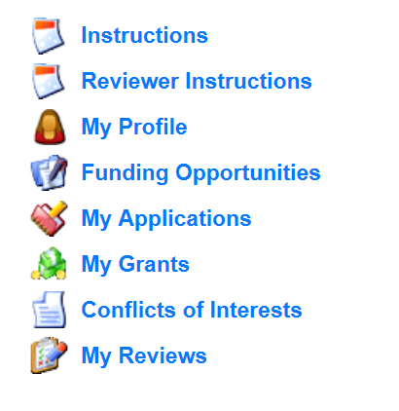
Application Instructions
Select “Funding Opportunities” and select the FY 2021 SHSP Combating Domestic Violent Extremism (CDVE) funding opportunity

Slide 28
Application Instructions, Cont.
Each project will need its own application
A project should not include both capability sustainment and building
Capability Sustainment – Projects that sustain capabilities at their current level
Capability Building – Projects that start a new capability, or increase a current capability level
Information provided in the application will determine the score, be sure requested information is provided and accurate

Slide 29
Application Instructions, Cont.
Select “Start New Application”
“Copy Existing Application” will not work as this is a new funding opportunity

Slide 30
Application Instructions, Cont.
After selecting “Start a New Application”, complete the “General Information” section
“Project Title” should be short and specific to the project, see example below
After completing the “General Information,” click “Save”

Slide 31
Application Instructions, Cont.
Select “Go to Application Forms”
Complete each of the five “Application Forms” with all required information then “Save” and “Mark Complete”
All forms must be marked complete in order to “Submit”

Slide 32
Contact Information
Authorized Official
The Authorized Official is the individual who has the authority to legally bind the applicant into a contract and is generally the applicant’s elected or appointed chief executive. For example:
If the applicant agency is a city, the Mayor or City Administrator shall be the Authorized Official
If the applicant agency is a county, the Presiding County Commissioner or County Executive shall be the Authorized Official (e.g.; the Sheriff is not the Authorized Official)
If the applicant agency is a State Department, the Director shall be the Authorized Official
If the applicant agency is a college/university, the President shall be the Authorized Official
If the applicant agency is a nonprofit, the Board Chair shall be the Authorized Official (This includes Fire Protection District’s)
If the applicant agency is a Regional Planning Commission (RPC) or Council of Government (COG), the Executive Director shall be the Authorized Official.
In order for an application to be considered eligible for funding, the agency’s correct Authorized Official MUST be designated in the “Contact Information” form and the “Certified Assurances” form

Slide 33
Contact Information, Cont.
Please complete all contact information for
Authorized Official
Project Director
Fiscal Officer
Project Contact Person
Required fields are designated with a red asterisk *
Click “Save” at the top of the screen after entering all of the information
Then “Mark as Complete”

Slide 34
SHSP Project Package
All of the “SHSP Project Package” information has been combined into one form with eight sections
A. Project Worksheet
B. Project Capability, THIRA and Dual Use
C. Project Background
D. Deployable/Shareable Resources
E. Audit Details
F. Risk Assessment
G. National Incident Management System (NIMS)
H. Certified Assurances

Slide 35
A. Project Worksheet
A.6 - Select the Project Activity Type that best represents your project
A.7 – Was this project previously funded with SHSP funds?
A.7.a – If you answered yes to Question # A.7, please give a brief description of the year and the project that was previously funded
A.8 Build/Enhance or Sustain, Is the project increasing capabilities (build/enhance) or sustaining capabilities (sustain) at the current level?
A.8.a/A.8.b - Attempts to coordinate, did your agency reach out to the RHSOC, local, or state agencies to see if the requested items are available?
All SHSP projects should be shareable/deployable so coordination is important to determine necessity

Slide 36
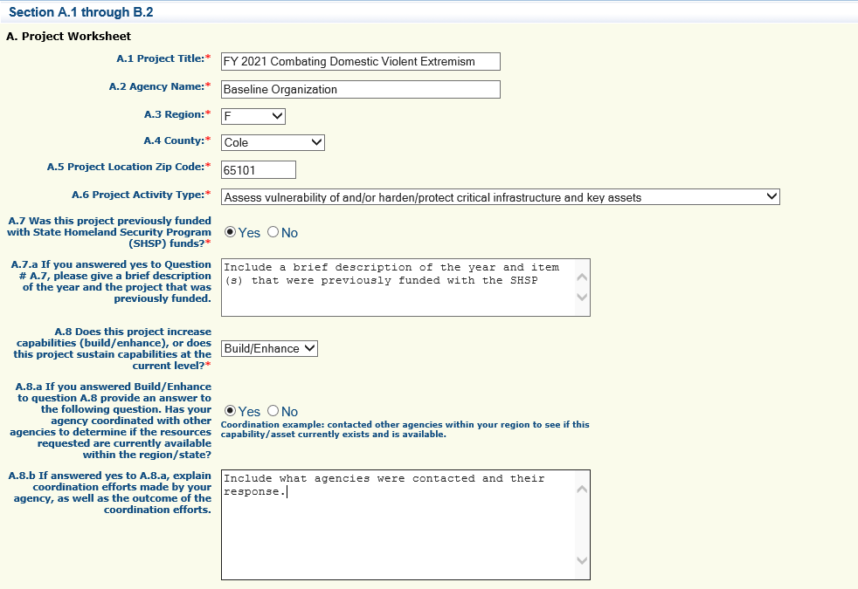
A. Project Worksheet

Slide 37
Project Worksheet Cont.
A.9.a – Provide the most recent population data for your jurisdiction
A.9.b - Provide a brief overall description of the project
A.9.c – Provide a summary of the specific project actions (What will grant funds be utilized to purchase/fund)
A.9.d – Provide an estimated time of how long the project will take to complete
A.9.e – Provide what objectives the project is designed to accomplish (the purpose of the project)
A.9.f – Describe how the project aligns with/increases terrorism preparedness
A.9.g – How does your project align with combating domestic violent extremism through civil unrest training and equipment to protect critical infrastructure and ensure the protection and safety of the citizens rights to peacefully assemble.
A.9.h - Explain why the project is necessary for the region/state
A.10 – Discuss the future sustainment plan for the requested item(s) in the application

Slide 38
A. Project Worksheet, Cont.

Slide 39
A. Project Worksheet, Cont.

Slide 40
B. Project Capability, THIRA and Dual Use
Review the FY 2019 State THIRA and FY 2020 SPR to answer Section B.
B.1 – After reviewing the FY 2019 State THIRA/FY 2020 SPR, choose the Primary Core Capability that best aligns to the project
B.2 – Explain how the project impacts the Capability Target on the THIRA/SPR for the Core Capability that you chose in B.1

Slide 41
B. Project Capability, THIRA, and Dual Use, Cont.
To find the Capability Target in the FY 2019 THIRA, search for the Core Capability you selected for B.1. The Capability Target will be listed underneath the Core Capability

Slide 42
B. Project Capability, THIRA, and Dual Use, Cont.
To find the Capability Target in the FY 2020 SPR, search for the Core Capability you selected for B.1. The Capability Target will be listed underneath the Core Capability

Slide 43
B. Project Capability, THIRA, and Dual Use Cont.
B.3 – Describe how the project supports terrorism preparedness and increases/supports preparedness for other hazards unrelated to terrorism

Slide 44
B. Project Capability, THIRA, and Dual Use Cont.
B.4 – Review the National Priorities in the FY 2021 SHSP Notice of Funding Opportunity (NOFO).
The project MUST align to the Combating Domestic Violent Extremism National Priority

Slide 45
C. Project Background
The purpose of this section is to identify if funding from SHSP has been provided for this project in the past

Slide 46
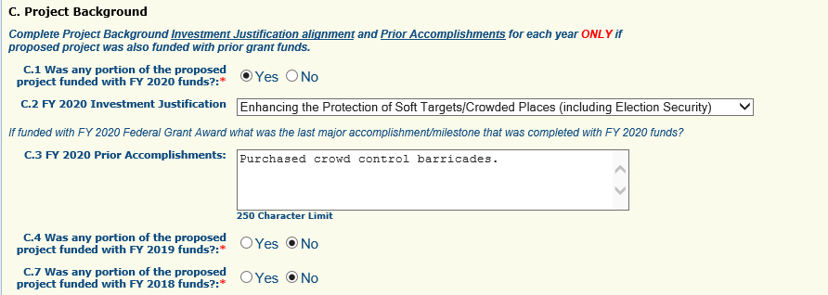
C. Project Background, Cont.
Additional information will need to be provided if you select yes to C.1, C.4, or C. 7

Slide 47
D. Deployable/Shareable Resources
A deployable resource is an asset that is physically mobile and can be used anywhere in the United States and territories via Emergency Management Assistance Compacts (EMAC) or other mutual aid/assistance agreements.
A deployable resource could be a communications vehicle, a generator, a CERT team, etc.
A mobile radio may also be a deployable resource if the radio is to be installed in a patrol car (patrol officer with radio are the deployable resource)
A shareable resource is an asset that can be utilized as a local, state, regional or national capability, but is not physically deployable (i.e.; fusion center)

Slide 48
D. Deployable/Shareable Resources, Cont.
D.2 Item Name – this refers to the Deployable/Shareable asset, this is not necessarily what is being purchased
An agency may be purchasing an item that is for sustainment or building of a larger asset, (i.e.; replacement SCBA tanks for a Homeland Security Response Team (HSRT) ) the team is the deployable asset instead of the SCBA tank
An agency may be purchasing a mobile generator, the generator would be the item that is deployable
An agency may be purchasing a portable radio for a law enforcement officer. The law enforcement officer with portable radio would be the deployable item

Slide 49
D. Deployable/Shareable Resources, Cont.
If the project does not support an asset that is deployable or shareable answer N/A and skip the remaining questions for Section D
Note: The information in Section D is used in the application scoring process

Slide 50
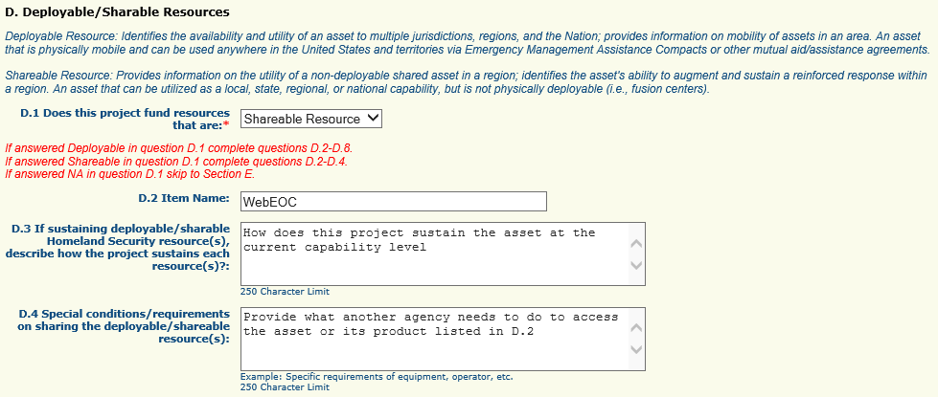
D. Deployable/Shareable Resources, Cont.
If the item is shareable, Sections D.2 – D.4 must be completed

Slide 51
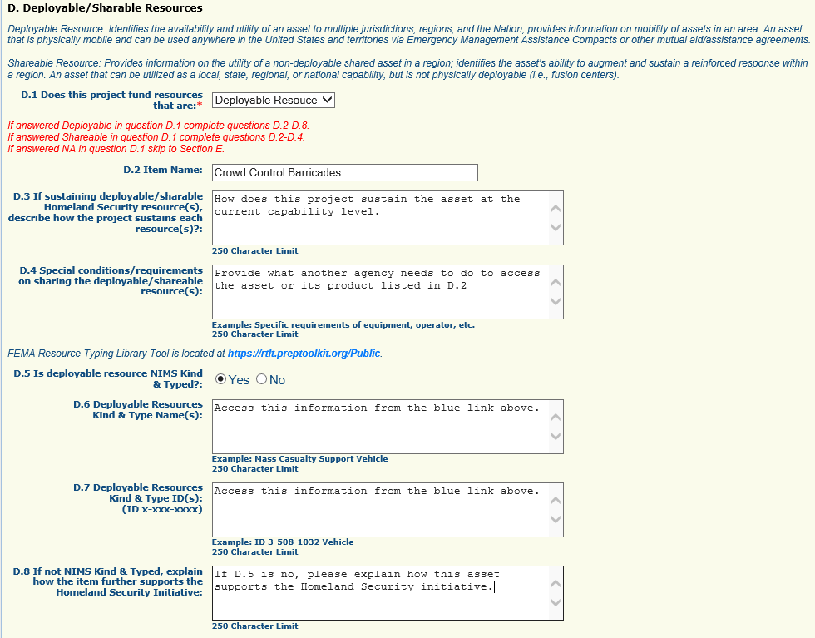
D. Deployable/Shareable Resources, Cont.
If the asset is deployable, complete all of Section D

Slide 52
D. Deployable Resources
Under the “NIMS Kind & Type” section of the form
Is the deployable resource kind & typed
Kind & Type Information
Provide ID number from Federal Website as well as the name https://rtlt.preptoolkit.fema.gov/Public
If the deployable resource is not kind and typed, provide a description of why the resource is necessary to further homeland security initiative(s)

Slide 53
D. Deployable Resources, Cont.

Slide 54
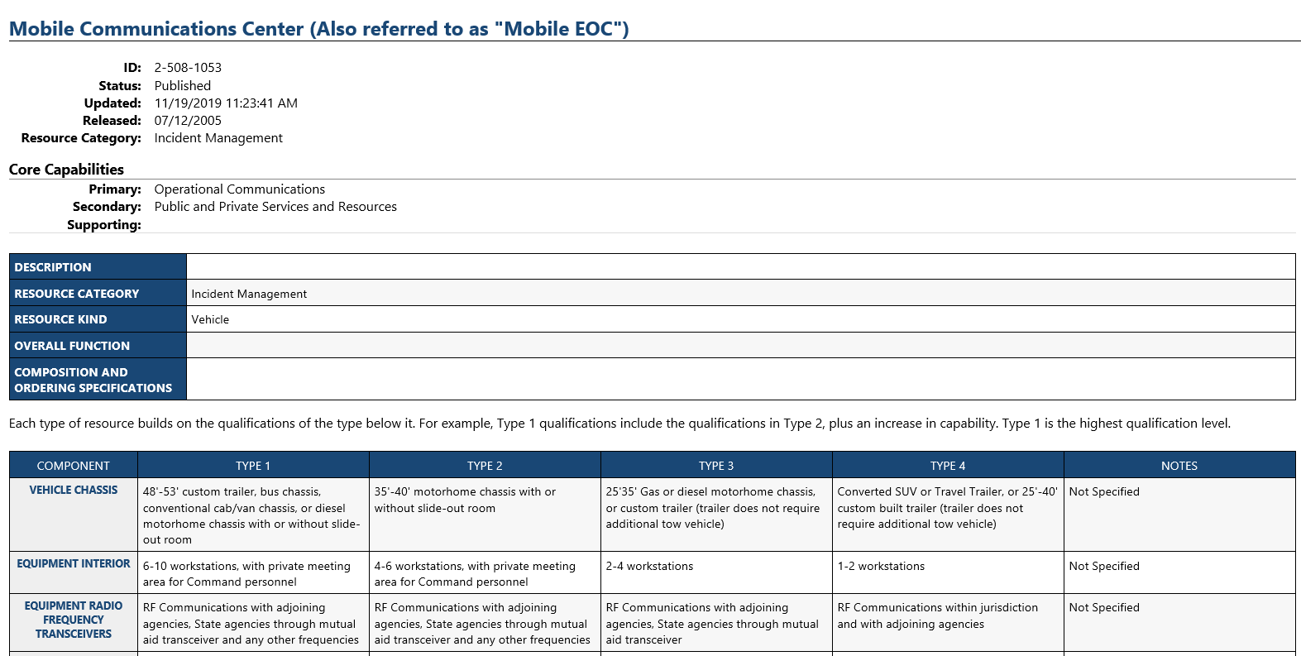
NIMS Kind and Typing

Slide 55
E. Audit Certification
Utilizing your agency’s most recent audit, please complete all required fields in the “Audit Details” section
If your agency does not have an audit, complete this section utilizing your most recent annual financial statement and attach the statement in lieu of the audit
*Note – If your audit covered a period that ended more than three years ago, please provide the most recent financial statement for your agency’s last fiscal year, as well as a copy of the audit
Please upload your Schedule of Expenditures of Federal Awards (SEFA) for the period covering your agency’s last fiscal year if this is not already included in your audit
All attachments will be uploaded in the “Named Attachment” form on the application

Slide 56
E. Audit Certification, Cont.
Utilizing the most recent audit, annual financial statement, and/or SEFA, complete the “Audit Certification” section indicate whether the $750,000 threshold for federal audits was met per Part 2 CFR 200.501
The $750,000 federal expenditure threshold is met when an agency has expended $750,000 or more in federal funds during their last fiscal year. This information can be found on the agency’s most recent audit, annual financial statements, and/or SEFA. (The total amount of federal funds expended is derived from all federal sources, not just Department of Homeland Security funds)

Slide 57
E. Audit Certification, Cont.

Slide 58
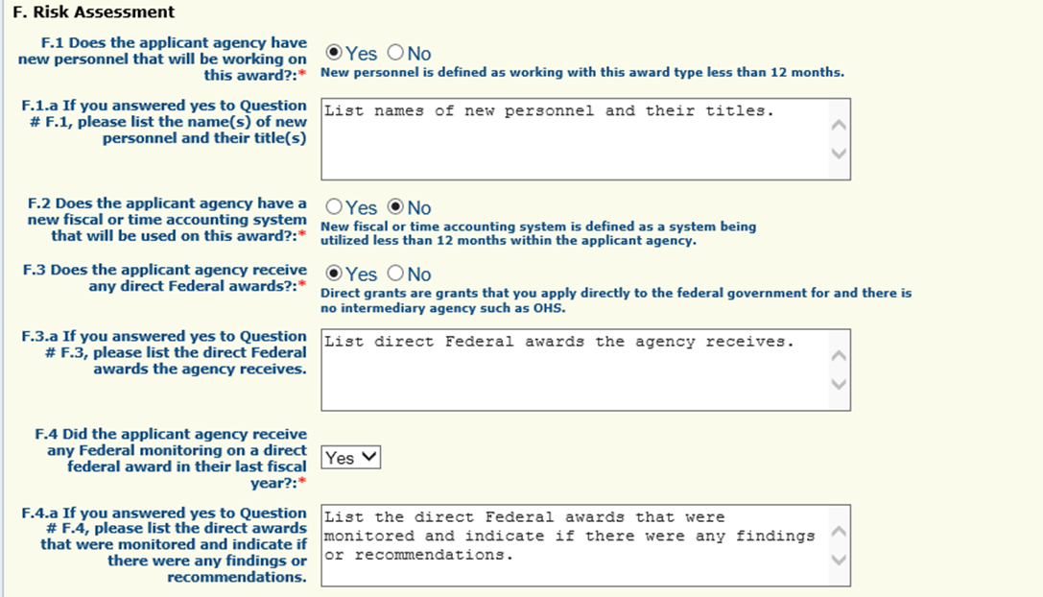
F. Risk Assessment
The “Risk Assessment” section is to gather information the awarding agency (OHS) will use to conduct a risk assessment, of your agency, as required by 2 CFR 200.331 (b)
Depending on the responses to these questions, the awarding agency may contact you for additional information

Slide 59
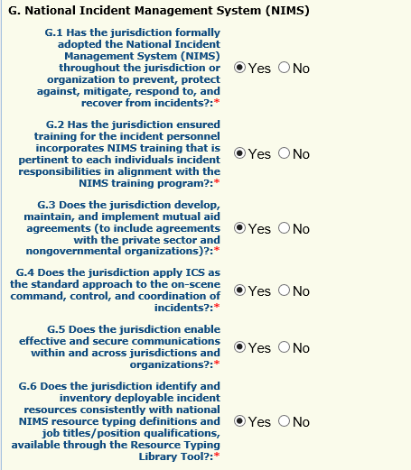
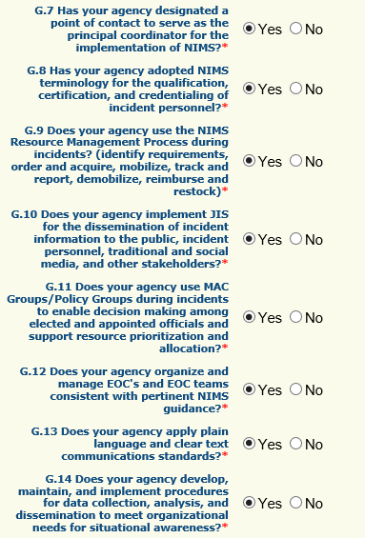
G. NIMS Compliance
Answer yes or no to the fourteen questions in the “National Incident Management System (NIMS)” section

Slide 60
G. NIMS Compliance, Cont.
If you answer no to any questions G.1-G.14 please explain planned activities during the grant period to strive towards NIMS compliance in G.15

Slide 61
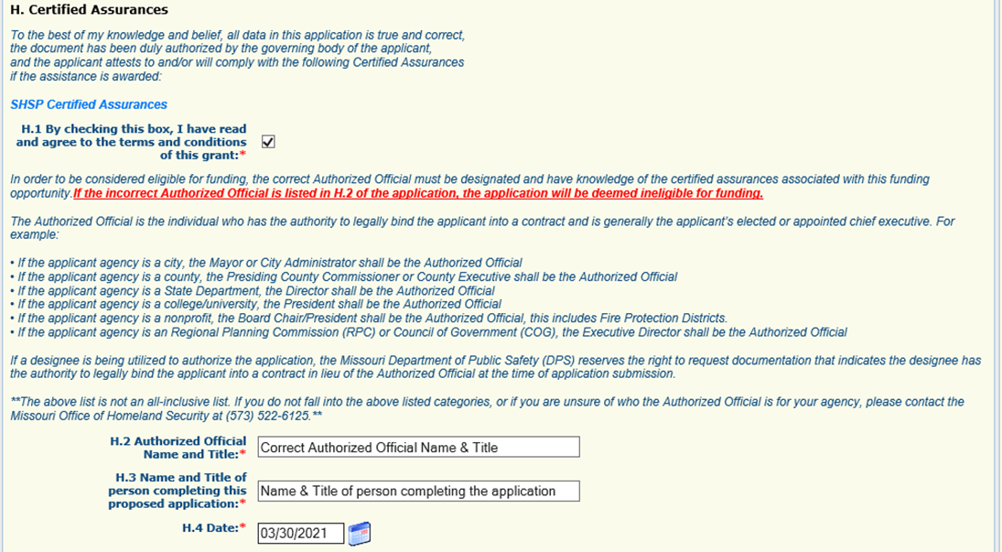
F. Certified Assurances
The “Certified Assurances” section MUST be completed with the agency’s correct Authorized Official to be considered eligible for funding
Applications can be saved without the Authorized Official’s information while they review, but MUST be completed before form can be marked complete and submitted

Slide 62
Budget Form
Enter each budget line by selecting “Add” and completing all required information, then “Save” and “Add” if additional budget lines are needed
Travel
Equipment
Supplies/Operations
Contractual

Slide 63
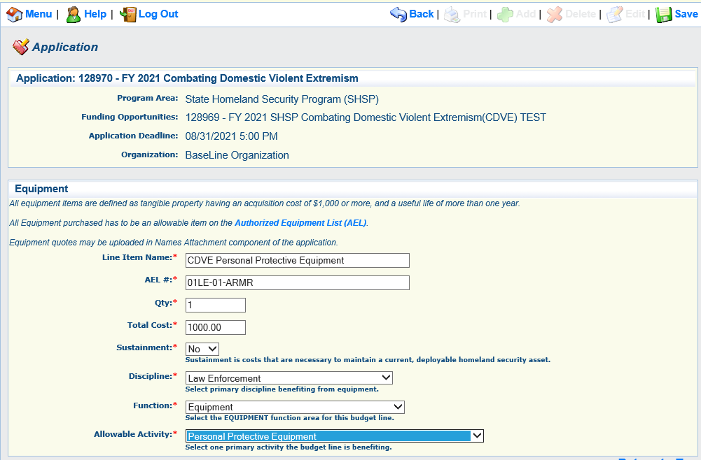
Budget Form, Cont.

Slide 64
Budget Form, Cont.
Provide required justification for all budget lines by clicking “Edit” at top of the page
Justification for all sections can be completed at one time

Slide 65
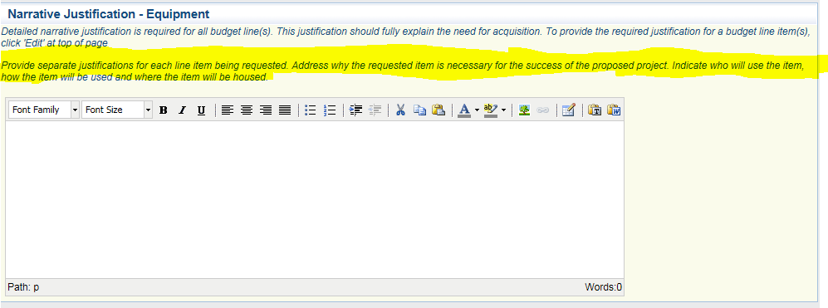
Budget Form, Cont.
The instructions for each budget section provides a description of what information should be included in the budget narrative justifications
DO NOT put “See attachment” in the narrative justifications! Each section must be completed. If you have information that will not fit in the justification, please enter a summary in the justification and then include the statement “Additional information can be located in the “Named Attachment” section
When justifications for all sections have been completed, mark “Save” and “Mark as Complete”at the top of page

Slide 66
Budget – Equipment
Equipment is defined as tangible, personal property (including information technology systems) having a useful life of more than one year and a per-unit acquisition cost of $1,000.00 or more
Authorized Equipment List (AEL) Number is required on the budget, link to site provided in instructions

Slide 67
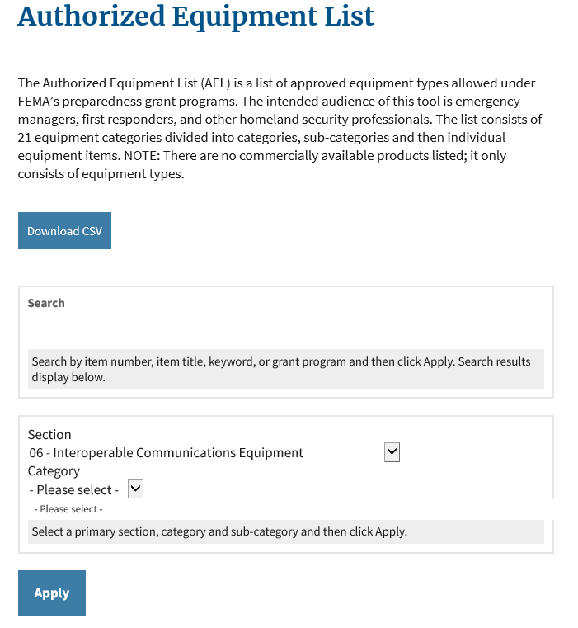
Budget Form – Equipment, Cont.
Search the site for the correct AEL number
The section name will correspond to the allowable activity on the budget line

Slide 68
Budget Form – Equipment, Cont.
Justification needs to include a cost basis for the amount requested
Please attach a quote or cost basis to the Named Attachments section of the application if available

Slide 69
Budget – Supplies
Justification should be provided for each supply requested to include
Justification for how the item supports the project
Why the amount requested is necessary
Cost basis - please attach a quote or cost basis to the Named Attachments section of the application if available
For a service that fits the criteria for supplies, the dates covered must be provided (e.g.; annual software license, phone, or internet service)

Slide 70
Named Attachments
All attachments must be included in this section
Required Attachments
Audit/Financial Statement
Federal Funds Schedule (if not included in the audit)
Other Supporting Attachments (if applicable)
Quotes or other cost basis
Other supporting information (up to 5 attachments)

Slide 71
Named Attachments, Cont.
To add each attachment select the name of the attachment
The applicant agency’s most recent audit/financial statement is a required document and must be uploaded before the form can be marked complete

Slide 72
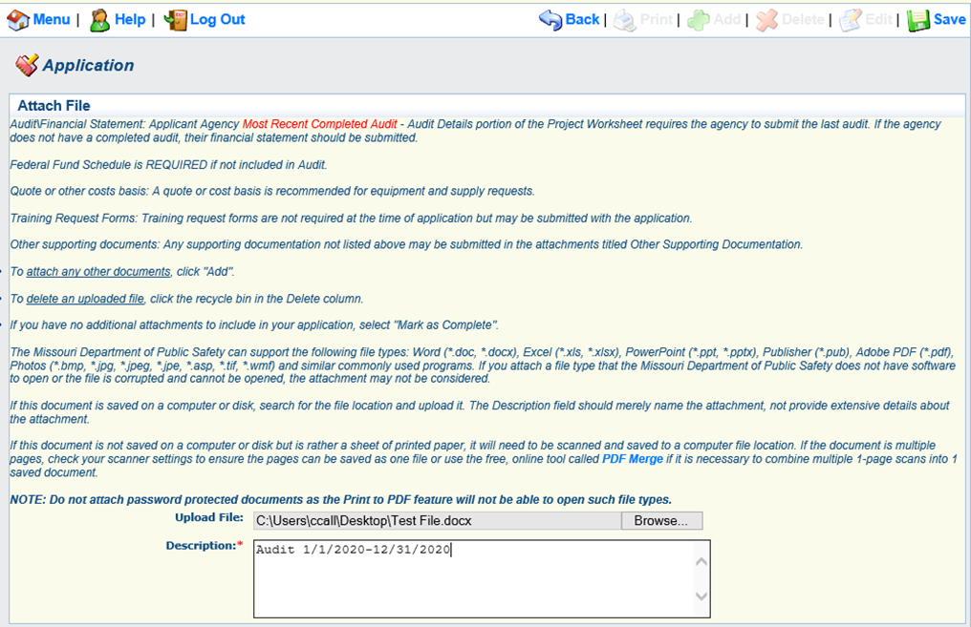
Named Attachments, Cont.
Browse to select document
Add a description to identify the document in the application, and select save

Slide 73
Submission
All forms must be marked complete in order to submit the application
When everything is complete select “Submit”

Slide 74
Administrative Review
During the administrative review process the following will be considered:
Allowable
Authorized Equipment List (AEL)
Authorized by law or regulation
Allowable in the Notice of Funding Opportunity
Allocable
Falls into POETE (Planning/Organization/Equipment/Training/Exercise)
Code of Federal Regulations (CFRs)
Within scope of the grant
Reasonable
Does not exceed what a prudent person would incur in the circumstance
Necessary
A cost that is required for proper and efficient performance of the grant

Slide 75
Office of Homeland Security
Points of contact for WebGrants system issues
Chelsey Call
Grants Supervisor
(573) 526-9203
chelsey.call@dps.mo.gov
Maggie Glick
Administrative Assistant
(573) 522-6125
maggie.glick@dps.mo.gov
Joni McCarter
Program Manager
(573) 526-9020
joni.mccarter@dps.mo.gov

